Slide 1
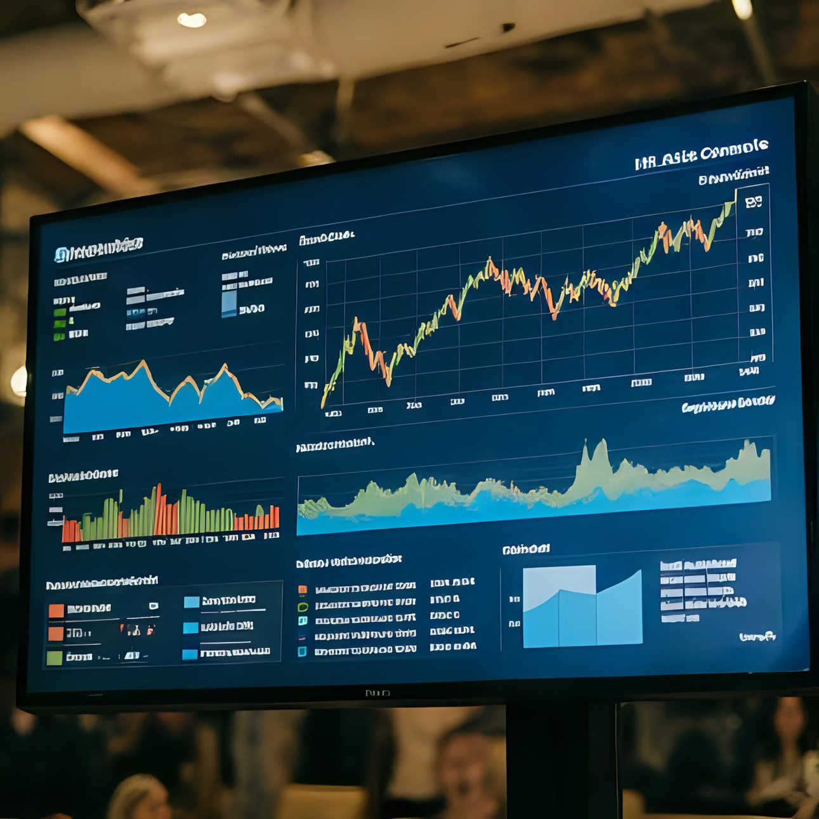
HR ATTRITION DASHBOARD
Tracking TurnoverTrends&At-RiskGroupsfor Strategic Action

Slide 2
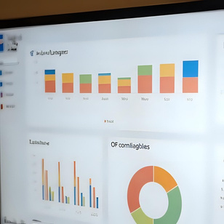


Developed an HR Attrition Dashboard by integrating SQL (data extraction), Python (data cleaning & preprocessing), Tableau and PowerBi (data visualization).
Project Overview
Analyzed attrition patterns across departments, roles, age groups, and salary levels, uncovering key trends and risk factors.
Delivered data-driven insights that enabled HR to design effective employee retention strategies.

Slide 3
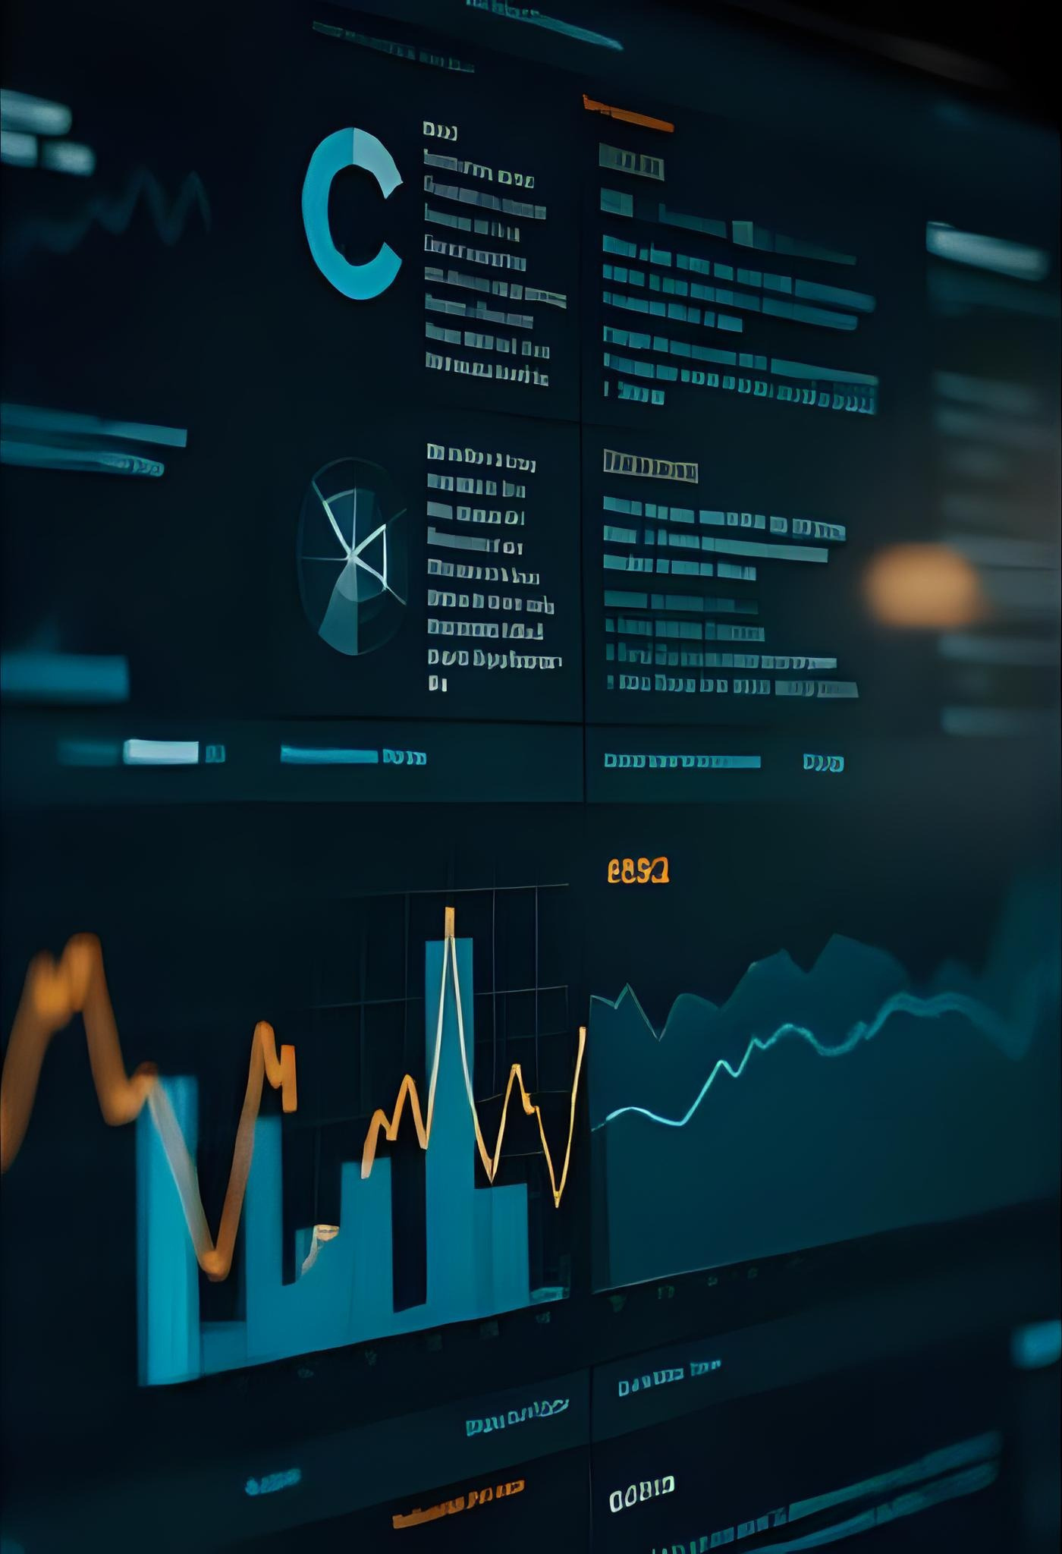
DATA & TOOLS USED
•Data Sources: IBM Employee
Records(Kaggle)
•Python: Data cleaning and preprocessing
•SQL: Data extraction
•Tableau & PowerBi : Dashboard visualisation

Slide 4




Key HR Metrics
1,470
237
1,233
16.12%
37 YRS
Employee Count
Attrition Count
Active Employees
Attrition Rate
Percentage of employees who left the company
Average Age
Total employees in the company
Peopleleftthecompany
Employees whoarestill working in the company
Typicalage of
employees in the company

Slide 5
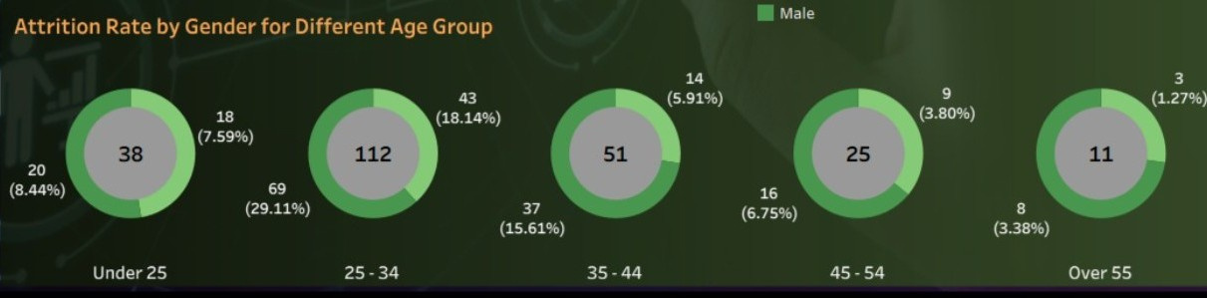
Attrition by Age Group
Highest attrition seen in the 25–34 age group. Lower attrition in older (45+) employees.
• This shows that mid-age level employees might be leaving due to career growth opportunities, workload, or salary expectations.

Slide 6

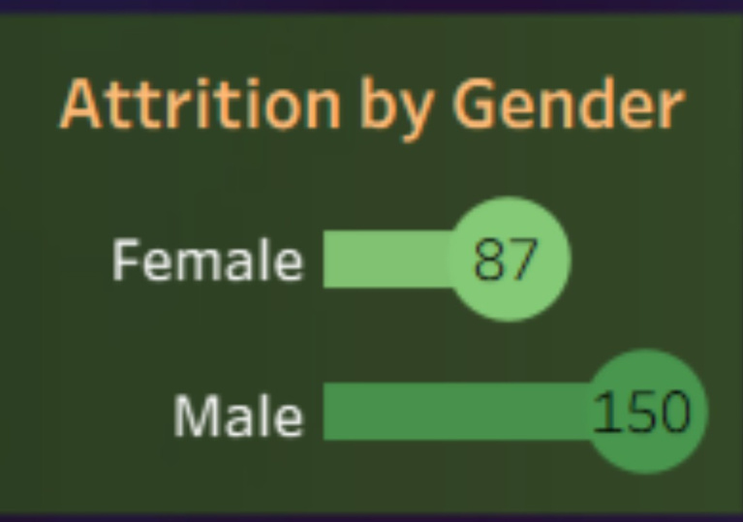
Attrition by Gender
Male employees contribute to a higher to
attrition females.
percentage
compared
Example: Out of 237 attritions, 150 were male and 87 female.
• This indicates HR may need to focus working
more
on
male-dominated
conditions.

Slide 7

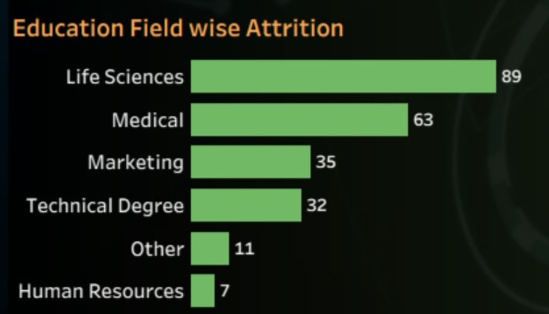
Attrition by Education Field
Highest attrition in Life Sciences and Medical fields. Lowest in Human Resources and Technical Degrees.
• Employees from Life Sciences/medical fields may be leaving for better-paying opportunities in other firms.

Slide 8
TABULAR Dashboard

Slide 9
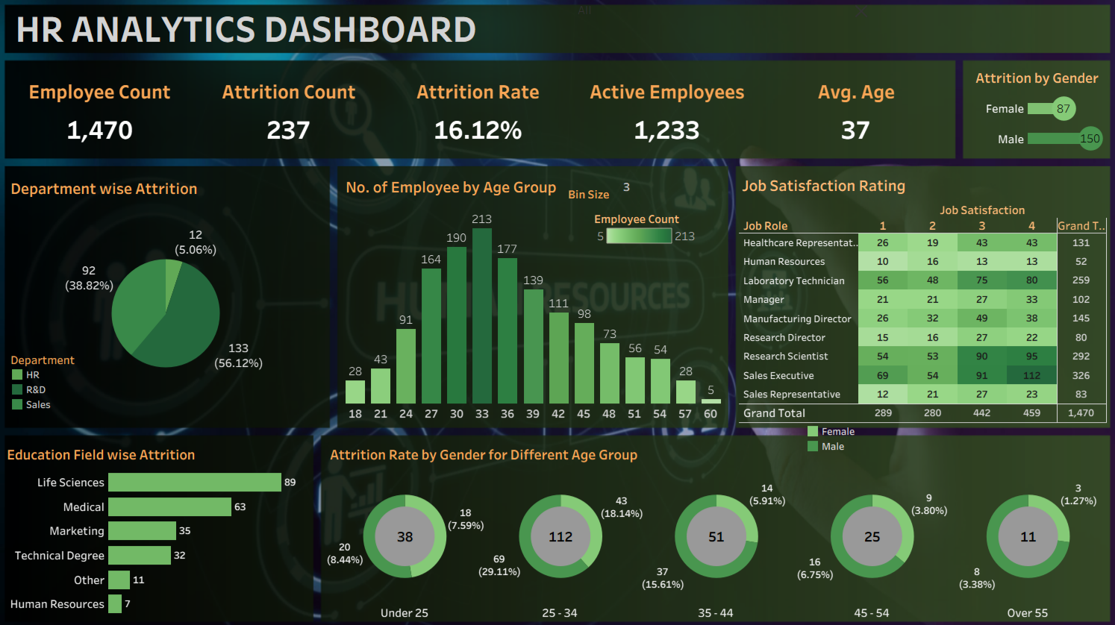

Slide 11
POWER BI Dashboard

Slide 12
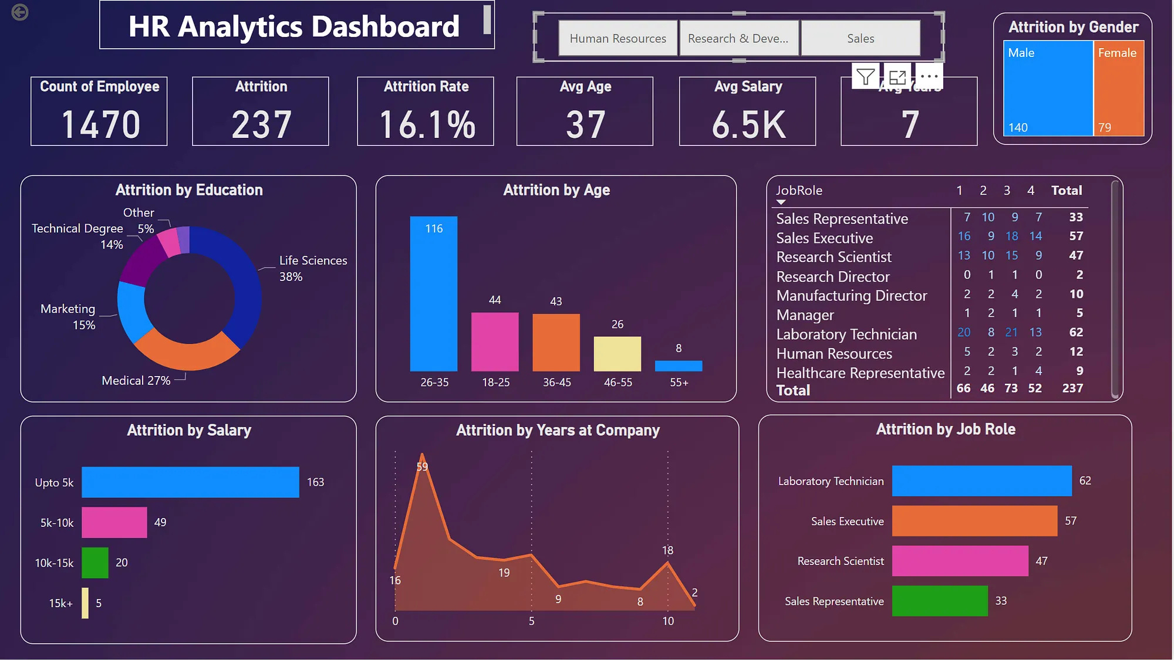

Slide 13
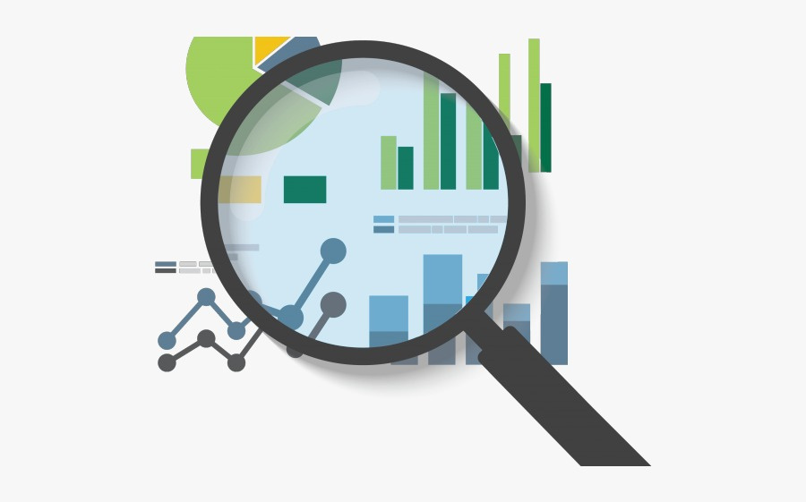
Actionable Insights
Implement career growth programs, mentorship, and promotion
pathways.
Introduce flexible work options, fair workload, and performance
rewards.
Adopt hybrid work models, flexible hours, and wellness
initiatives.
Actionable Insights
Conduct regular salary reviews and provide competitive benefits.
Launch employee surveys, recognition schemes, and team-
building.
Offer retention bonuses, training sponsorships, and career
planning.
Track attrition monthly with dashboards and adjust strategies
proactively.

Slide 14


